Slide 1

Remembering Mithras: Is VR an Effective Tool to Learn About the Past?
Twitter: @debmayers24​
Website: http://debmayers.com
Sketchfab: https://sketchfab.com/debmayers24
Notes:
Before I begin, I want to preface this talk saying that I will be talking a bit about storytelling, 3D models and (re)construction. These reconstructions, are not portraying the ancient world exactly as it would have been, rather they are reflections of current knowledge about the past and based on someone's interpretation, and in this case-my interpretation.

Slide 2
Overview
What is VR?
Using VR for learning
Building the experience
Experimental design
Results
Conclusions
Notes:
So today, I am going to go over my experiment about using VR for learning about the past. At the time I started this research there was relativyl little published about whether people could actually learn from using 3D models and VR and this new spatial layout of data and really wheterh or not it actually worked for people to remember content presented.

Slide 3
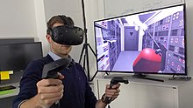
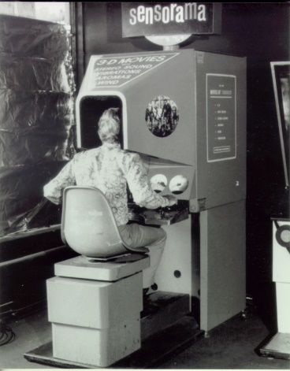
What is VR?
Sensorama Image. (2018). Wikimedia Commons. Retrieved from https://commons.wikimedia.org/wiki/File:Sensorama-morton-heilig-virtual-reality-headset.jpg ,
Vive Image (2017). Wikipedia. Retrieved from https://sco.wikipedia.org/wiki/Virtual_reality ​
Notes:
How many people have heard of Virtual Reality? How many have tried it? Okay. For a really brief history, VR started off as this big machine built in the 1950s called the sensorama, a person would stick their head in and be able to see content and move with some hand controls, I would sort of equate it to the beginning of computers with the mainframe. Today, VR is typically known as a head mounted display seen here at the top. High end VR allows people to walk around a physical space and the virtual world reacts to their movements. This is the true power of VR. The virtual space reacts to my physical movements. I become embodied in the space and this is really important for certain types of learning. But why would we even use VR for learning?

Slide 4
Bailenson’s Rules for VR
Expensive
Impossible
Rare
Dangerous
Notes:
Jeremy Balienson from Stanford writes there are 4 rules to putting an experience into VR. If something is expensive, dangerous, impossible, or rare. This directly relates to learning about the past, many sites do not currently exisit it is impossible to go there, many artifacts are behind glass cases in museums, it is rare to hold and use them, and sometimes we cannot access sites due to political, contextural, or environmental issues, and this is perhaps where VR can help because it is expensive or dangerous to visit a site. And of course, relating this to learning about a site, and how it was used in the past, one of the use cases for VR in education, and I do say this with reservation, is that it ‘allows us to time travel’. By using 3D models we are able to give a representation of how the past may have looked like, and not only that. We can take decontexturalized objects from museums and put them back into a context. With 3D models it is possible to show multiple interpretations and change over time show how the site looks now, versus when it was discovered, to how it may have looked in the past. But with VR, we are able to place someone into a virtual scene, have them walk around, interact with objects, and perhaps understand things in a fuller way.

Slide 5
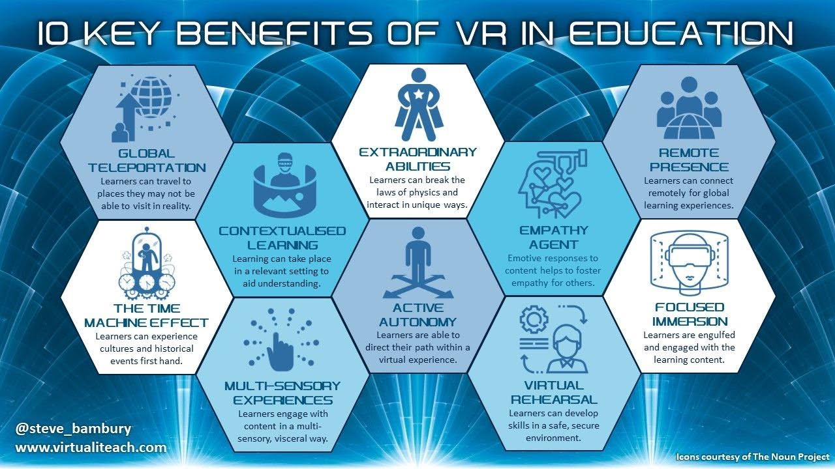
Bambury, S. (2019, March 31). 5 Key Barriers to VR Adoption in Schools. Retrieved from https://www.virtualiteach.com/single-post/2019/03/31/5-Key-Barriers-to-VR-Adoption
Notes:
Steve Bambury highlights 10 benefits of using VR. Specifically related to learning about the past, is Global Teleportation, or having the ability to visit somewhere in VR if unable to physically go to the site. Contexturalised learning, it is possible to take artifacts from a museum, display them as they were found in a virtual archaeological site, and then going ‘back in time’, the time machine effect, to look at how it may have been used. And of course, VR is very sensorial. The visual stimuli is the most prominent, followed by audio, and haptic feedback, it is even possible to use scents. However, despite this nice diagram, there is not a lot of research on whether people can actually learn from a VR experience better than by video or texts. Which directly relates to how we learn about Ancient History, is VR an effective tool to learn about the past?

Slide 6
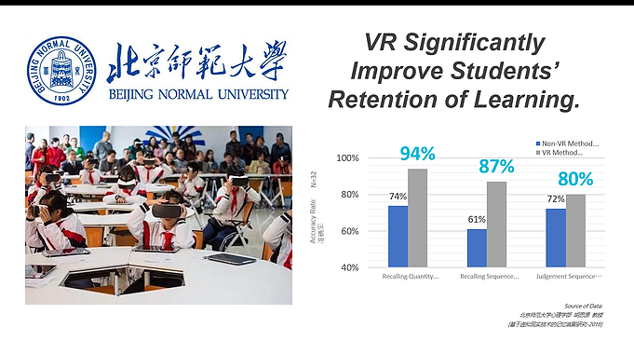
Bambury, S. (2019, March 31). 5 Key Barriers to VR Adoption in Schools. Retrieved from https://www.virtualiteach.com/single-post/2019/03/31/5-Key-Barriers-to-VR-Adoption
Notes:
Beijing Normal University showed that inside VR content was remembered more than outside. I wasn’t able to go deeply into this study due to language barieer, but there is another study done by Warwick with similar results.

Slide 7
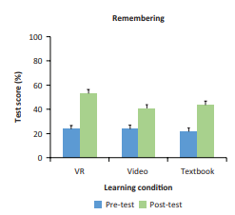
Warwick University: Plant Cell
Text, Video, VR
Post: 50%, 43%, 57%
Pre: 25%, 28%, 28%
VR and textbook better than video
Allcoat, Devon and von Mühlenen, Adrian (2018) Learning in virtual reality : effects on performance, emotion, and engagement. Research in Learning Technology, 26 . 2140 . doi:10.25304/rlt.v26.2140
Notes:
They showed students, a 3D model and text about a plant cell. The VR condition remembered more content than the video and textbook. It also showed that inside VR students felt more confident about their answers, and preferred to use VR over other means.

Slide 8
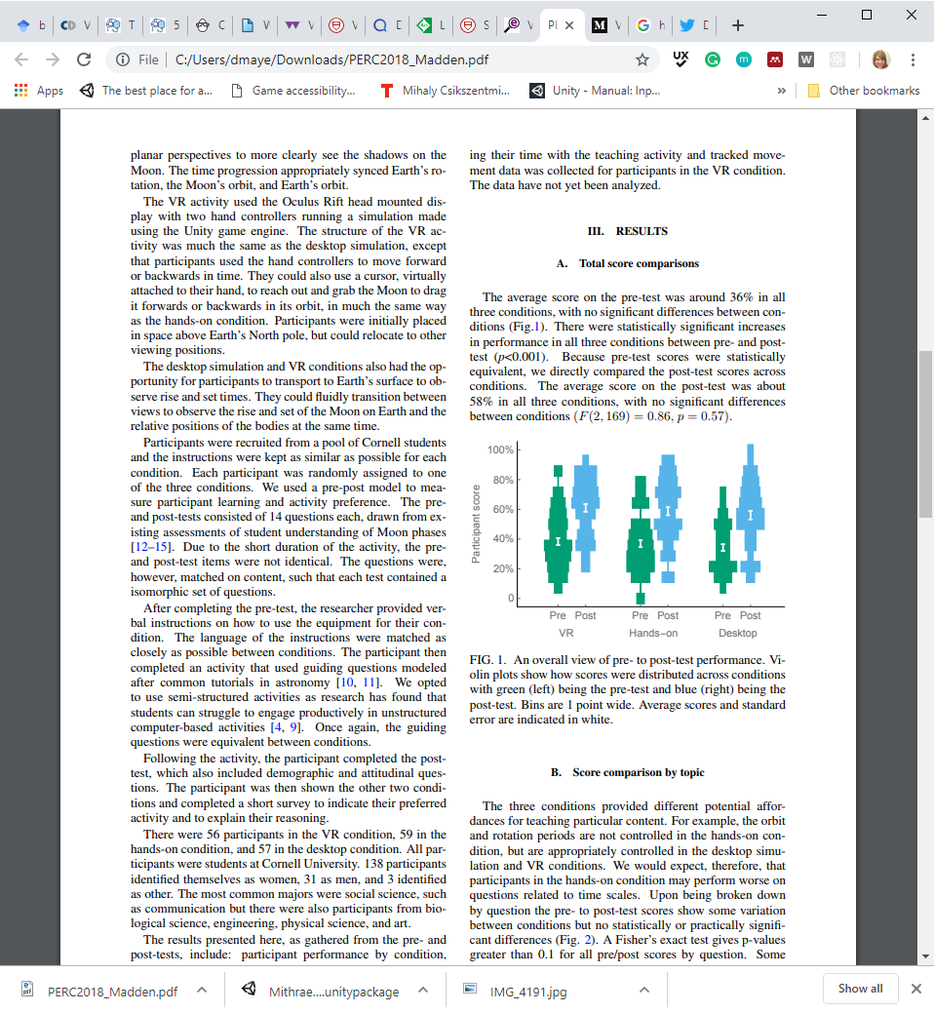
Cornell University: Moon Phases
Pre: 36%
No significant difference
Post: 58%
Madden, J., Won, A., Schuldt, J., Kim, B., Pandita, S., Sun, Y., Stone, T., & Holmes, N. (2018, August 1-2). Virtual Reality as a Teaching Tool for Moon Phases and Beyond. Paper presented at Physics Education Research Conference 2018, Washington, DC. Retrieved from https://www.compadre.org/Repository/document/ServeFile.cfm?ID=14819&DocID=4966
Notes:
However, there have also been studies like this one done at Cornell, which shows that there is no difference between VR and a desktop computer when learning about the moon phases. While the students prefer to use VR because it is more engaging, and perhaps because it is the latest technology, there was not a difference in the three conditions. So how well can we use VR?

Slide 9
Advantages of VR
Training-Physical
Spatial
Dynamic
Visualising content (i.e. Chemistry)
Notes:
It is really good for an experience that is leveraging embodment. Training, visualizign and manipulating content. Being able to walk around a scene in history, looking at the painting styles on the wall, or viewing a sculpture from all angles.

Slide 10
Disadvantages of VR
Physical Effects (i.e. eye strain, motion sickness)
No Guidelines/Best Practices
Making content fit an experience
Cost
Notes:
But there are some disadvantages as well. The main two are related to health and safety and the cost. A high end VR system requires an expensive computer, and a headset totalling roughly £1,500. There also is not really any guidance for creating these experiences. We know that embodiement is the best, and experiential learning, but how do we show the past inside of an experience?

Slide 11
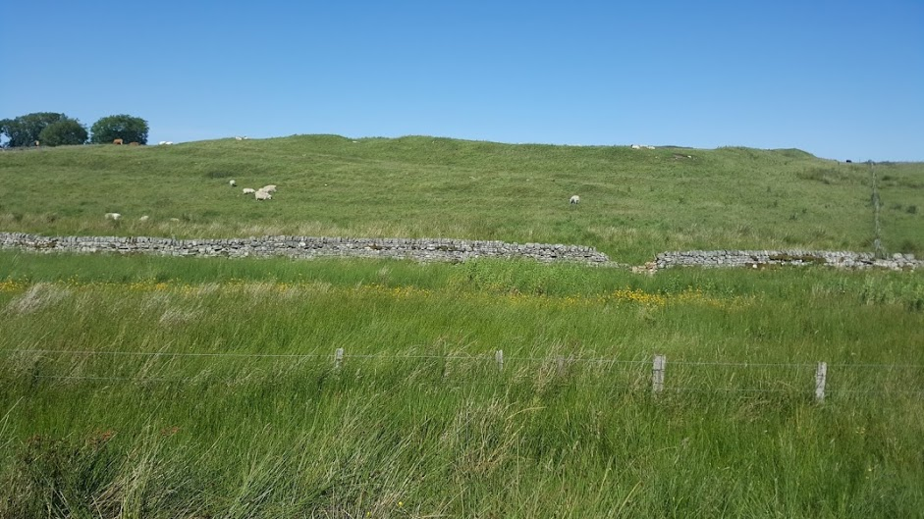
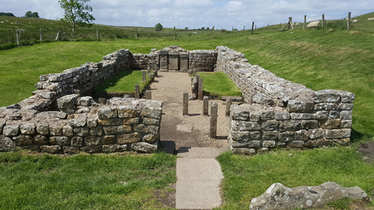
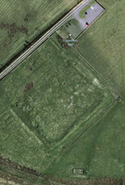
Why Carrawburgh?
Notes:
In order to look at this question, I decided to create an experience of the Temple to Mithras at Carrawburgh to see if people can learn from the VR experience. The reason I chose this site is because, the first time I went there, the dirver of the 122 AD bus said ‘Are you sure you want to go here? There’s nothing there.’ And when I got off the bus and started walking around, I saw what he meant. I didn’t understand where the gates were, I could not imagine a wall or the fort, how people would be milling about and the vicus. And then there was this temple. Which had some artifacts, but not all of them, and there is a placard which gives some information, but really not a lot. So I chose Carrawburgh because it is hard to interpret, and not many people know of it. The first time I went there, the bus driver asked me twice if I was ‘sure’ I wanted to go there because there really wasn’t much to see.

Slide 12
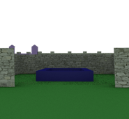
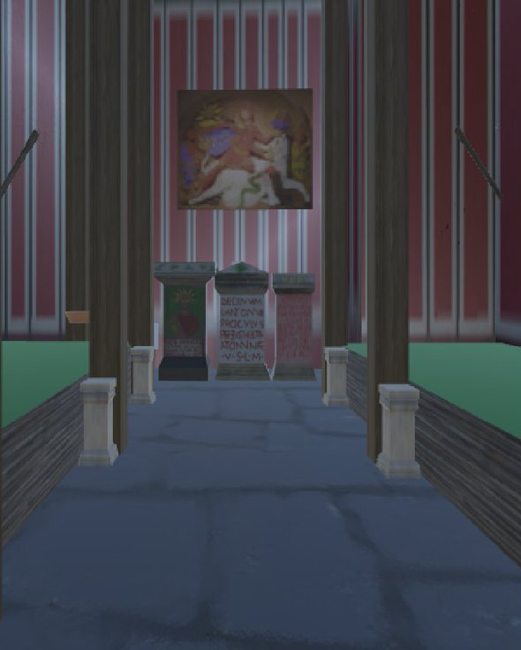
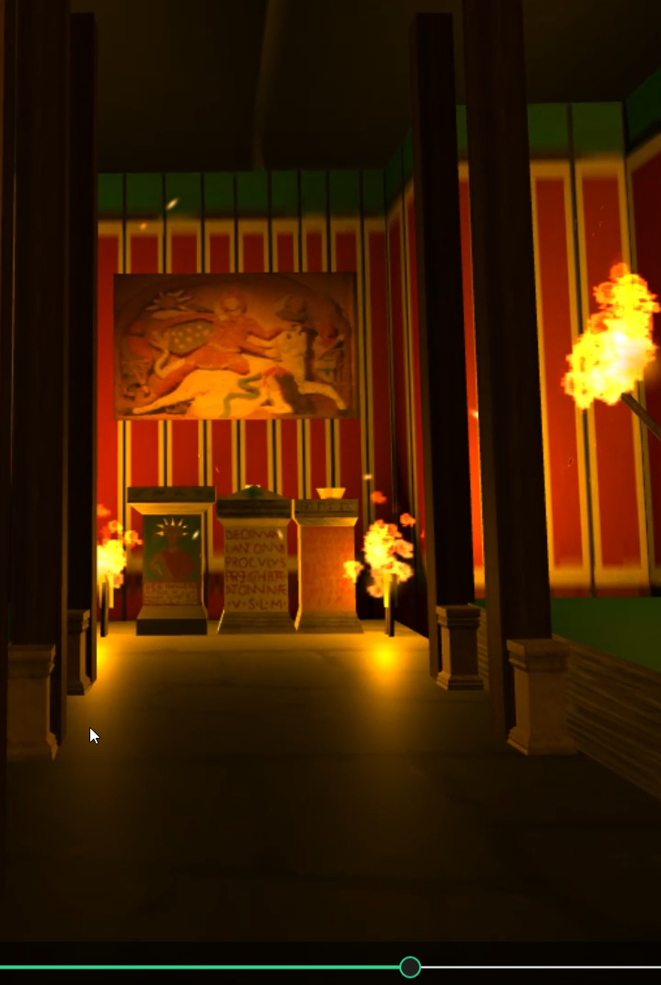
Building the Experience
Notes:
But as I read the archaeological reports, and dug a bit more into the history, I became fascinated with the site, and the temple to Mithras. I originally wanted to have people go through the whole fort, but ended up deciding that was to big of a task to build the entire fort, and decided to do an interpretation of the 4th century state of the temple. I had learned a bit of 3D modelling skills, and started to build up the temple to scale, and then also was able to use the models of Cautes and Cautopates curtosey of Newcastle University, and because the cult statue was not found at the site, I used the one from Housesteads and painted it using GIMP.

Slide 13
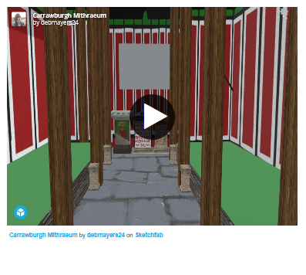
Modelling the Mithraeum
Notes:
At that point, I felt pretty good about how the temple was looking, and asked people to move around it in VR and give their initial impressions. People thought it was cool, but didn’t understand what everything was. So I decided to add some torches, and objects for the participant to use while in the space and decided to start storytelling.

Slide 14
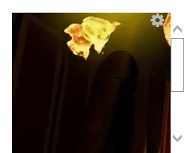
Experience Design
E-Learning and Experiential Learning
Voice of Mithras telling participants information
Light the torches for upcoming ceremony
Ability to move freely and grab objects
Notes:
Thus the 3d Model and being in the space, became more of an experience. I used parts of e-learning and epxeriental learning to guide my decisions about how to make the experience. I knew VR was very powerful for embodiement, so I had the partipant go through the experience as Prefect Marcus Simplicius Simplex, who’s name is on one of the altars in the temple. I gave participants a map of the temple before they put the headset on and allowed them to explore in their own time. I created a script so a person could be the voice of Mithras and relaying information about the temple and cult such as ‘smell the scent of pine’ or the ranks of the cult, and the symbolism of the iconogrphy. I had the participant light torches inside the temple, saying it was for the upcoming initiation ceremony. And participants were able to grab obejcts and do what they wanted in the space. I originally was going to test if people learned better in VR, in VR with scent of pine, or by video, but was not able to do all of these.

Slide 15
Experimental Design
Pseudo-Longitudinal, Between Subjects Design
Independent Variable: Time the Learning Questionnaire was Distributed.
Dependent Variable: Participant Score on the Questionnaire.
Pre-Experience, Post-Experience, and Learning Questionnaires
Notes:
The experiment tested particpants knowledge before they entered the experience, right after, and 10 days after. I asked them questions relating to the information the voice of mithras gave throughout the epxeriemtn and allowed them to add their own comments at the end. Before they started the experience I gave participants a pre-experience questionnaire which asked about hteir knowledge of the Romans, their profession, age, and how often they used VR. Most of the particpants had used VR less than 3 times. After the experience I also gave the post-experience questionnaire which asked them about their level of presence inside of the experience, or the psychological feeling of ‘being there’, and how their senses were involved. And acutally, this worked quite well.

Slide 16
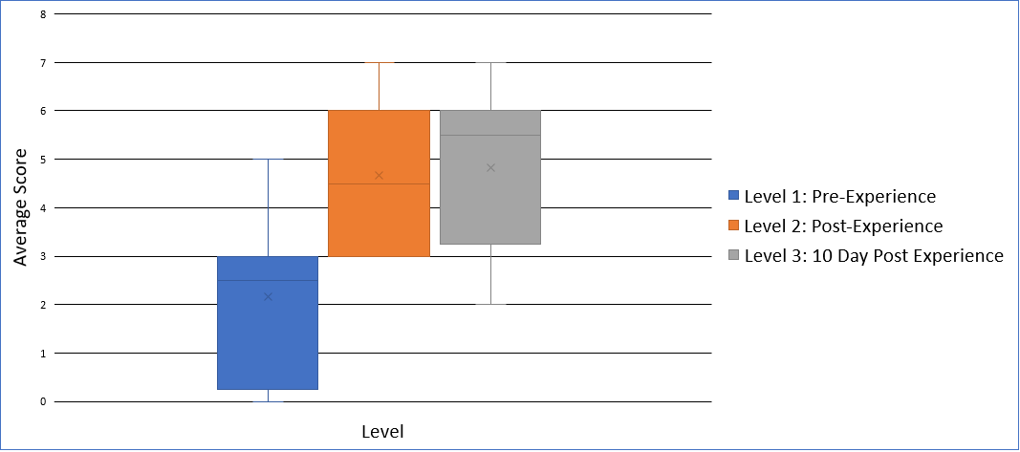
Learning Questionnaire Score
Notes:
There was a significant difference between before taking part in the experience and directly after, as well as before and ten days later. There was no statistical difference between the two post experience questionnaires which does suggest that people remembered the content from the experience. There were 7 questions total, and on average people answered around 4-6 correctly on the post experiments. So this isn’t ground breaking, and I don’t think it really would go over well as a replacement for materials for an exam.

Slide 17
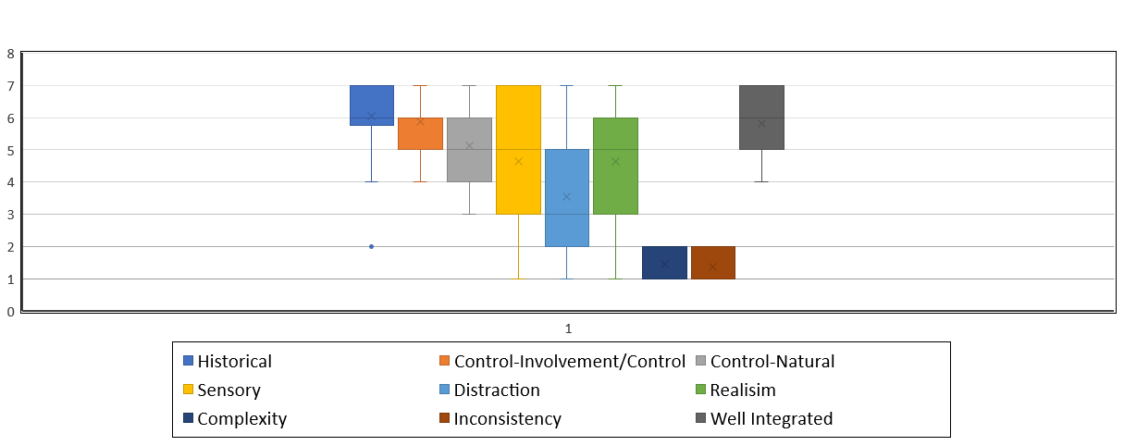
Factors Measured
Notes:
Positively, people thought the content was historically accurate, and that it was easy to use and understand the experience. There was a wide range in sensory, distraction and realism factors which could have been due to the environment (which was not always equal, my computer sometimes had a bit of lag or there were extraneous noises due to the construction going on outside). However, most interestingly was the sensory component. I asked a range of questions related to the senses, as I was going to see if people would learn more if they were in VR with the scent of pine.

Slide 18
Lessons Learnt
The story and interaction matters
Think about sensory engagement
Realism isn't as important
Multiple interpretations
Show the current site and the past
Allow free exploration
Notes:
So some of the lessons I’ve learnt, are up here, but I really want to focus a bit on the senses first. VR is a multisensory application, people treat experiences inside of VR as if they were reality. Getting the sensory engagement to be a bit better, especially in relation to the audio and haptics, may have helped people explore more, remem It is an extremely powerful tool for embodiement. If we can leverage embodiment then VR is a great tool for learning. It gives free exploration about a space, understanding of how museum objects could have been used, and allows people to manipulate the objects. It also allows for multiple interpretations of sites. My interpretation of this temple, is likely vastly different to someone elses., and with 3D modelling and VR we are able to show that. We can also have time lapses, and show the change from the past to the present AND THE ability for lectures to be in VR where the lecturer can spend calucalted time based on an algorthim looking at each student in the eye, so they will pay attention, but that may be a little far off to have virtual teaching. However, most of the applications at the moment are something that do not take advantage of what VR offers, and aren’t really conducive to learning.

Slide 19
Is VR an Effective Tool to Learn About the Past?
Notes:
Overall, is VR an effective tool. To an extent. If we are trying to figure out sightlines, spatila orientation, what it was like to walk around a sculpture, or how far up Trajan’s column could you see from the ground, what it was like to live in the past, VR is a great medium. It allows us to put a person in a space, become embodied, increase empathy and change behaviour, but many applications are not ready to do this. I am currently running my study again to see if video or VR is more effective of people remembering details, and the preliminary results echo other studies that have recently been published, indicating that people remember more content from videos, but prefer to use VR. So at the moment it should really just be an enhancement to texts and lectures.

Slide 20
Sources
https://commons.wikimedia.org/wiki/File:Sensorama-morton-heilig-virtual-reality-headset.jpg ,
https://sco.wikipedia.org/wiki/Virtual_reality ​
https://www.af.mil/News/Article-Display/Article/1414771/researchers-test-virtual-reality-adaptive-flight-training-study/​
Madden, J., Won, A., Schuldt, J., Kim, B., Pandita, S., Sun, Y., Stone, T., & Holmes, N. (2018, August 1-2). Virtual Reality as a Teaching Tool for Moon Phases and Beyond. Paper presented at Physics Education Research Conference 2018, Washington, DC. Retrieved April 3, 2019, from https://www.compadre.org/Repository/document/ServeFile.cfm?ID=14819&DocID=496 6
https://www.virtualiteach.com/single-post/2019/03/31/5-Key-Barriers-to-VR-Adoption
Allcoat, D., & A. von Muhlenen. (2018) Learning in virtual reality: Effects on performance, emotion and engagement. Research in Learning Technology. 26:2140

Slide 21
Remembering Mithras: Is VR an Effective Tool to Learn About the Past?
Twitter: @debmayers24​
Website: http://debmayers.com
Sketchfab: https://sketchfab.com/debmayers24
Github: https://github.com/dmayers340/unityMithraeum
Notes:
Hi all. I’m Deb, for a brief background on me before I begin. I did a bachelors degree in Classical civilization and Business. My main focus points in these were art, archaeology, and identity in the Roman Frontiers and Pscyhology of Consumers and entreprunship. Then I worked at a lab in Behavioural Economics, where I learned about psychology and beahviorual sciences and tried VR for the first time. Continued on to a Masters in Ancient Cultures looking at reconstructing ancient sites and am now finishing up a conversion Masters in computer science by writing a dissertation on the efficacy of VR as a tool to learn about ancient sites while working as part of the Tech Connect grad program here.
Before we dive in, I want to quickly point out this word (re)create. It is deliberately put into these parenthesis to denote that these reconstrcutions, are not portraying the ancient world exactly as it would have been, rather they are reflections of current knowledge about the past. Because we will never know things about the ancient world with 100% cerntatinty, we must always rembemer that reconstructions are contingent on research and someone’s point of view and interpretations while we continually find out more about ancient civilizations. Of course, this does not differ from what you see in museums already. Where many artifcacts have been restored to show a more complete object.

